Slide 1
Cancer Immunotherapy at a glance
Department of Biochemistry and Biotechnology
Samuel Terkper Ahuno
Mphil Biochemistry Candidate 2020
Ekwame001@gmail.com

Slide 2
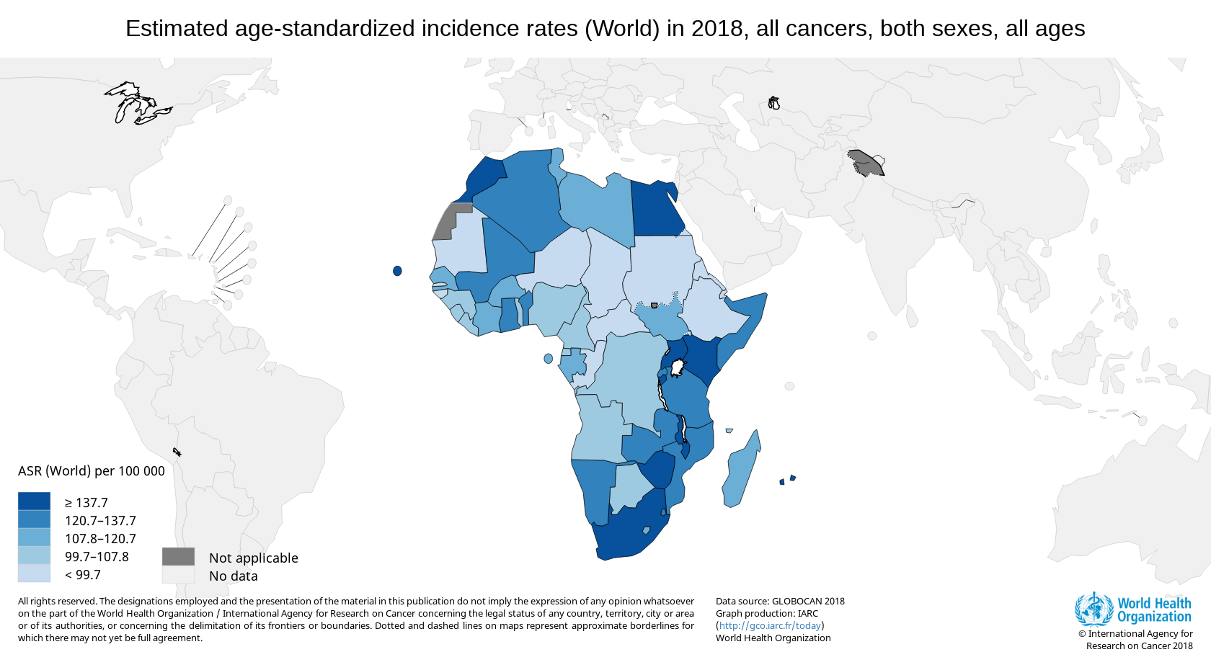

Slide 3
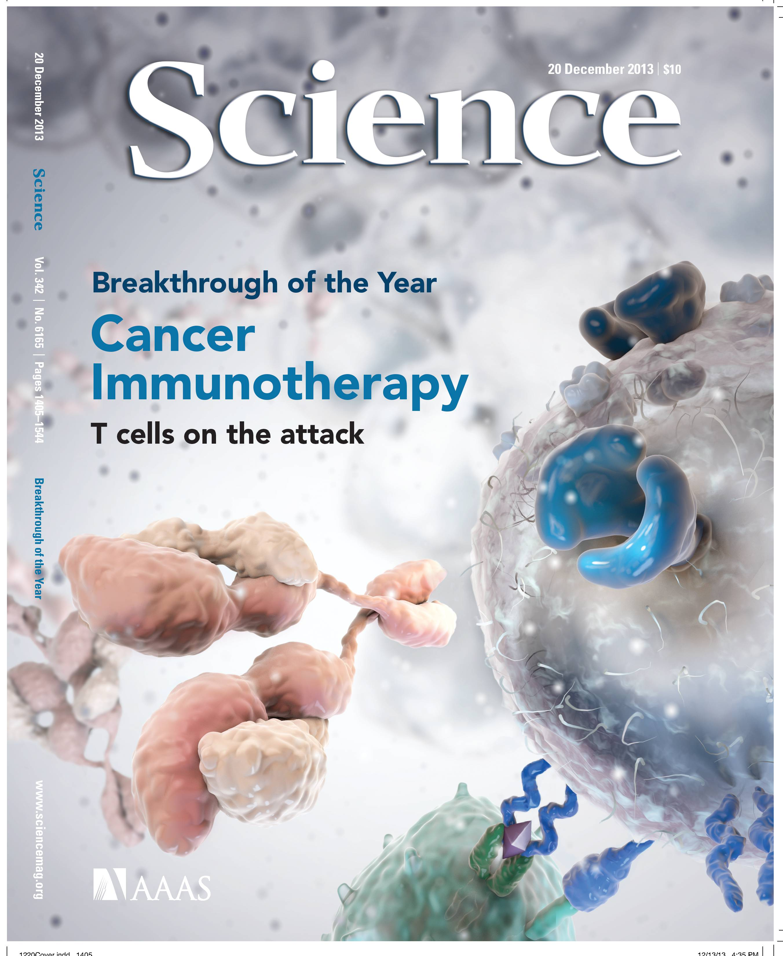
December, 2013
Science. 2013 Dec 20;342(6165):1432-3

Slide 4
Why “breakthrough of the year”?
Remarkable results in cancer patients using multiple immunotherapies
CAR (Chimeric antigen receptor) therapy for B cell leukemia
Anti-CTLA-4 & Anti-PD-1 therapies for advanced melanoma (checkpoint inhibitors)

Slide 5
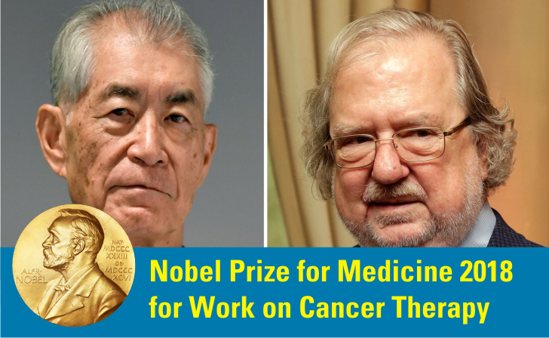
James P. Allison & Tasuku Honjo

Slide 6
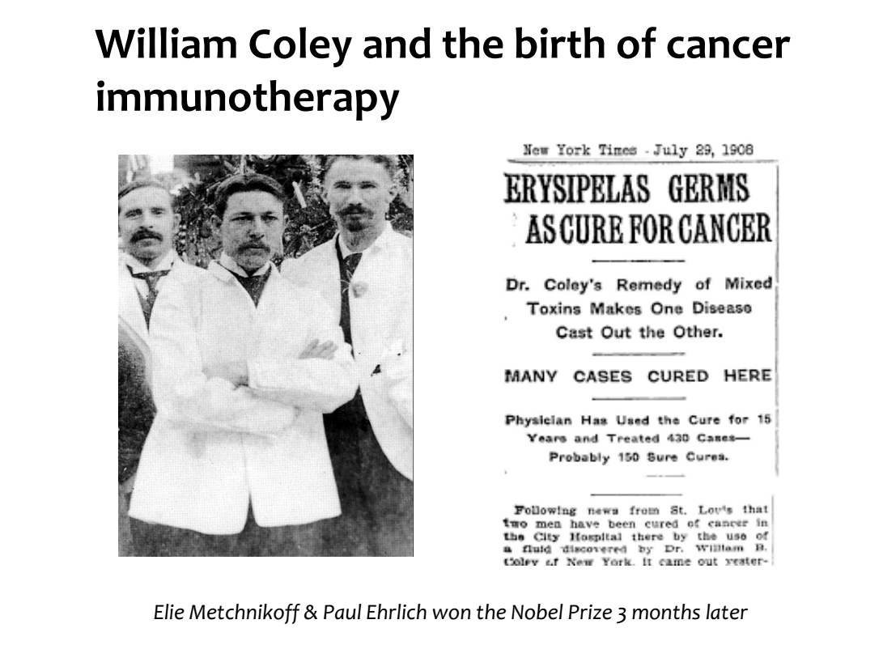

Slide 7
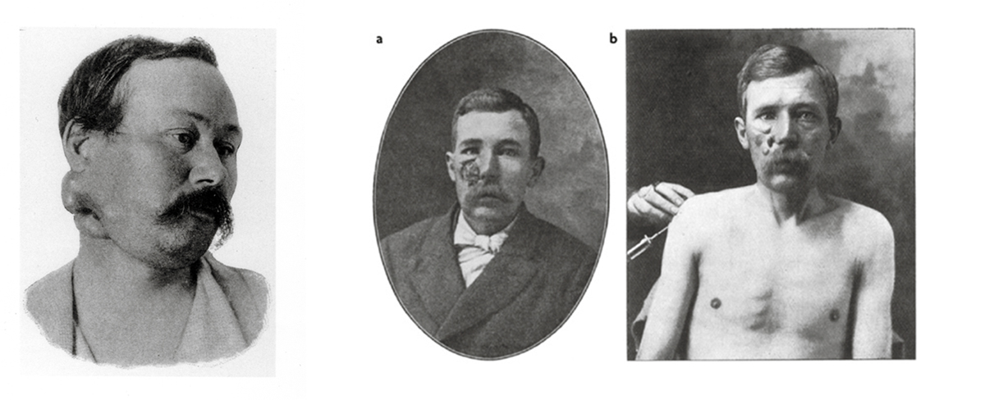
Coley’s Toxins (1891)
Observation: Cancer patients with erysipelas had tumor regression
Admixture of heat-killed S. pyrogenes and S. marcescenes injected into tumors daily (weeks to months)
Side effects: fevers, chills

Slide 8
Coley’s Toxins (1891)
104 inoperable soft-tissue sarcoma patients treated before 1940 (Compiled by Nauts, Flower, Starnes)
17 (16%) disease free but lost to FU 5-10 years
15 (14%) disease free but lost to FU 10-20 years
22 (21%) disease free up to 20 years

Slide 9
Evolution of cancer therapy
Previously
Anti-cancer drugs indiscriminately killed proliferating cells
Paradigm shift
New agents enhance anti-tumor immunity

Slide 10
Examples of Immunotherapy
Monoclonal antibodies
Vaccines directed against tumour-associated antigens (tumour peptides)
Adoptive cell therapy (e.g. T effector cells transfusion)
Cytokines (IL-7, IL-15, and IL-21), or inhibitors of cytokines (TGF-β) or their signaling pathways (CTLA-4).

Slide 11
Why cancer Immunotherapy?
Specificity
Memory
Adaptability

Slide 12
Goals of cancer immunotherapy
To expand and/or activate the patients adaptive immune response to specifically target/kill cancer cells

Slide 13
Immune Responses
 | Innate | Adaptive
Response rate | Minutes/Hours | Days
Specificity | Shared structures | Antigen-Specific
Diversity | Limited | Very Large (~10¹⁸)
Memory | (NK cells) | Yes
 | -intracellular | -T lymphocytes
 | Phagocytic cells | -B Lymphocytes
 | -Macrophages
 | Dendritic Cells
 | NK Cells

Slide 14
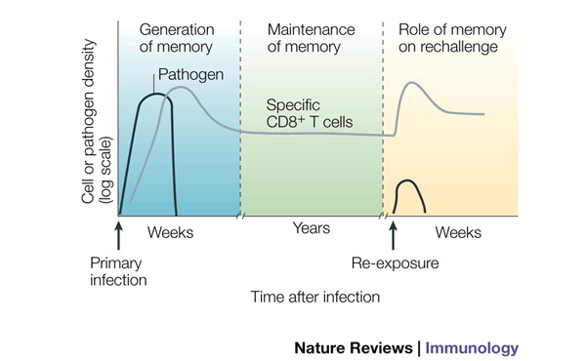
CD8+ T cell Response to infection

Slide 15
Effective & Durable T cell Response
Recognition
Proliferation
Effector function
Cytokine secretion (IFN-y, TNF-a, etc.)
Killing of infected cells
B cell help
Memory formation

Slide 16
Biological Challenges
Cancer cell-induced immune suppression
Immune incompetence
-Age
Immune Tolerance (Peripheral and Central Tolerance)

Slide 17
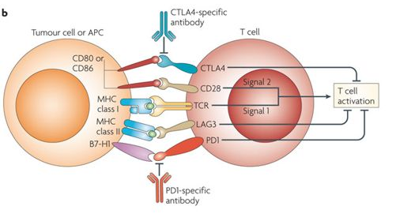
T cell activation- Start the car
Drake CG. Nat Rev Immunol 2010;10:580–593

Slide 18
Putting on the brakes
Drake CG. Nat Rev Immunol 2010;10:580–593

Slide 19
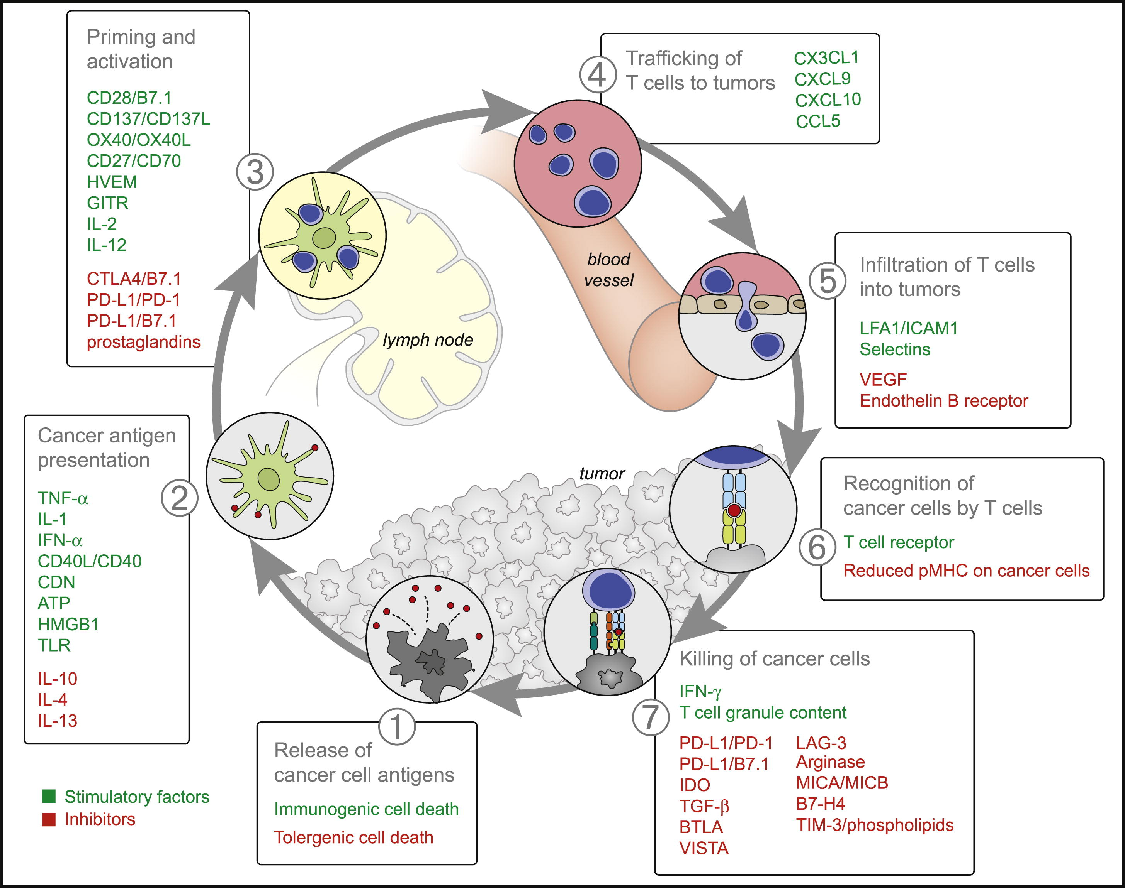
Stimulatory and Inhibitory Factors in the Cancer-Immunity Cycle
Immunity Volume 39, Issue 1, 25 July 2013, Pages 1-10

Slide 20
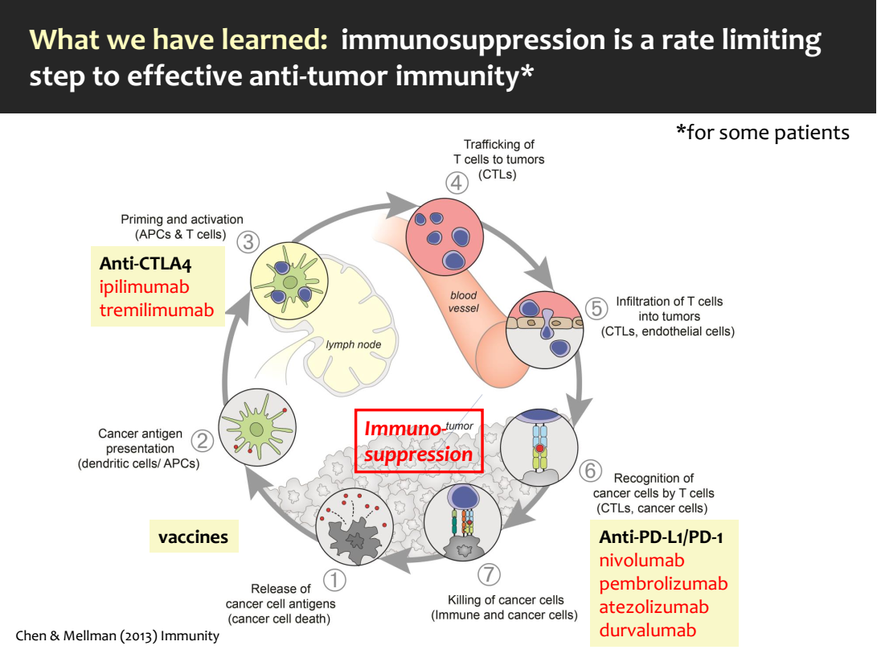

Slide 21
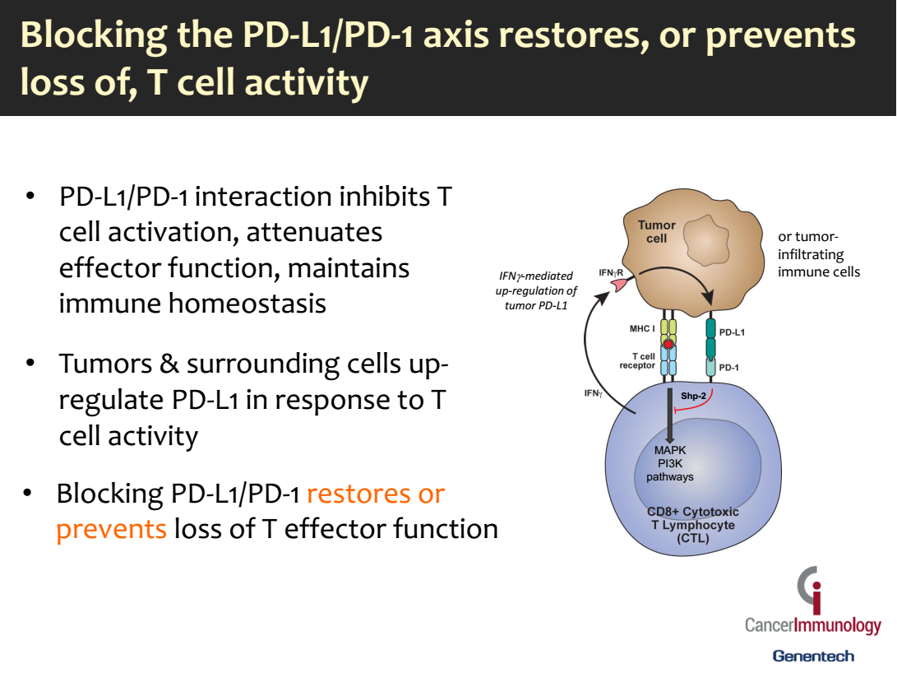

Slide 22
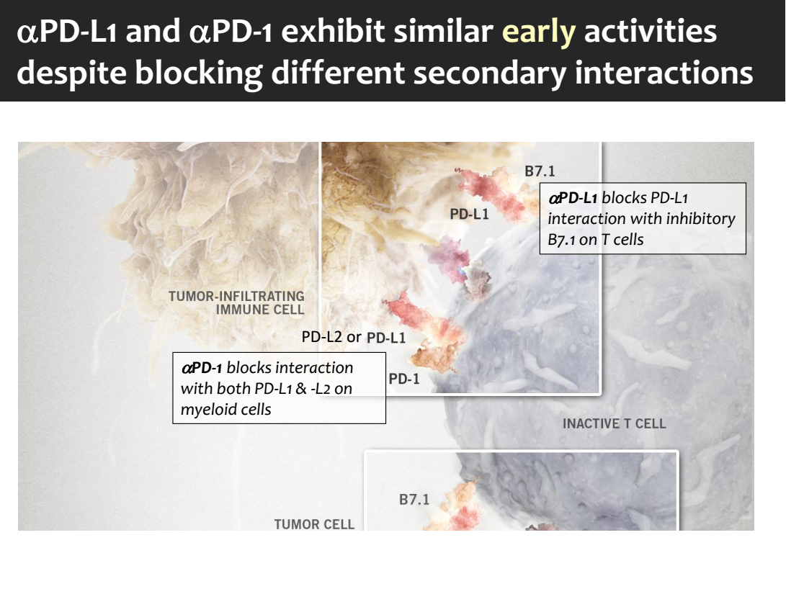

Slide 23
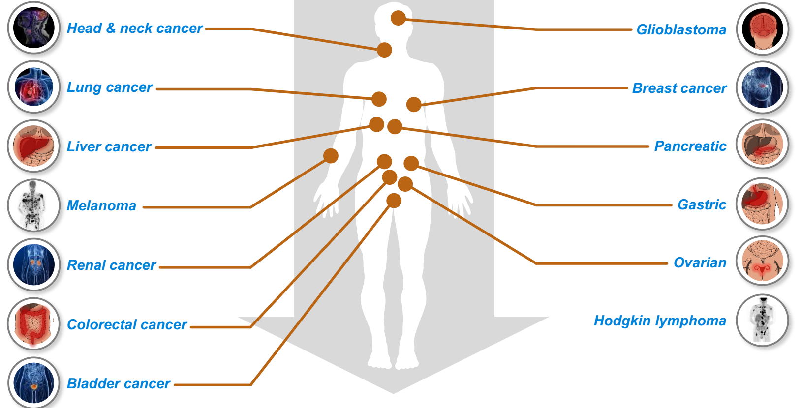
Broad activity for anti-PD-L1/PD-1 in human cancer
Broad activity, but only subset of patients benefit: ~10-30%

Slide 24
Immune Checkpoint Blockade
Paradigm shift in cancer therapy
Do not target tumor cells
Do not involve vaccines or cytokines to turn “on” immune response
Works by blocking inhibitory pathways to unleash anti-tumor immune responses

Slide 25
Cancer immunotherapy in 2018
FDA-approved Immune Checkpoint Inhibitors
1 Anti-CTLA-4 antibody
Ipilimumab (Yervoy)
2 Anti-PD-1 antibodies
Pembrolizumab (Keytruda)
Nivolumab (Optivo)
3 Anti-PDL-1 antibodies
Atezolizumab (Tecentriq)
Avelumab (Bavencio)
Durvalumab (Imfinzi)

Slide 26
Checkpoint Inhibitors
Cancer Type | Anti-CTLA4 | Anti-PD1 | Anti-PDL1
Metastatic Melanoma | x | x
Metastatic non-small cell lung cancer (NSCLC) (Lung) |  | x | x
Metastatic squamous cell carcinoma of the head and neck |  | x
Recurrent Hodgkin’s Lymphoma |  | X
Advanced Urothelial Cancer |  | x | x
Advanced Renal Cancer | x | x
Advanced/Mets Gastric or GE Adenocarcinoma |  | x
Progressive HCC (Liver) |  | X
Metastatic Merkel Cell Carcinoma |  |  | x
Metastatic Solid Tumor with MMR or MSI |  | x

Slide 27
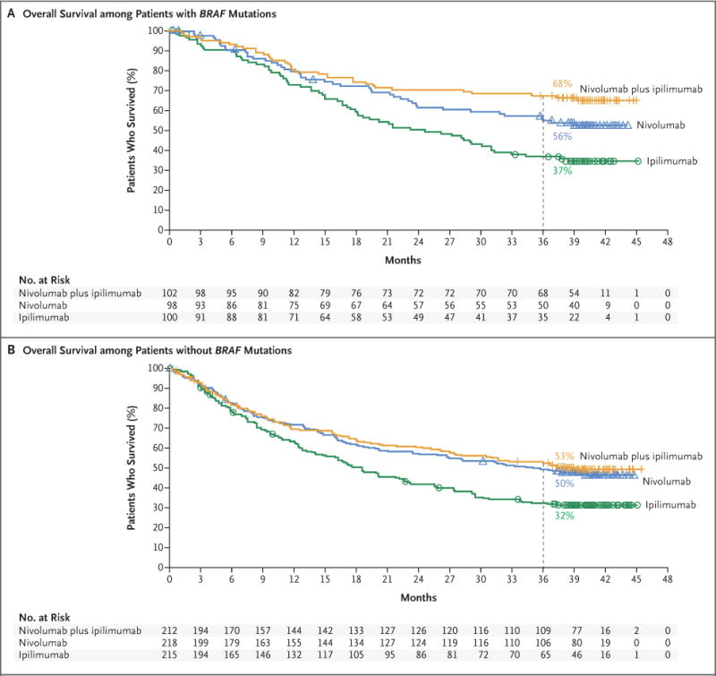
Combination therapy is more effective (Advanced Melanoma)
N Engl J Med. 2017 Oct 5; 377(14): 1345–1356.

Slide 28
Immunotherapy in Ghana?
-Surgery
- Radiotherapy
- Chemotherapy
- Hormone therapy
- Biologic therapy (Immunotherapy) ??
Presently there are only two centers (KBTH in Accra and KATH in Kumasi) that offer the full treatment for Breast cancer.
Source: National Strategy for Cancer Control In Ghana (2012 - 2016)

Slide 29
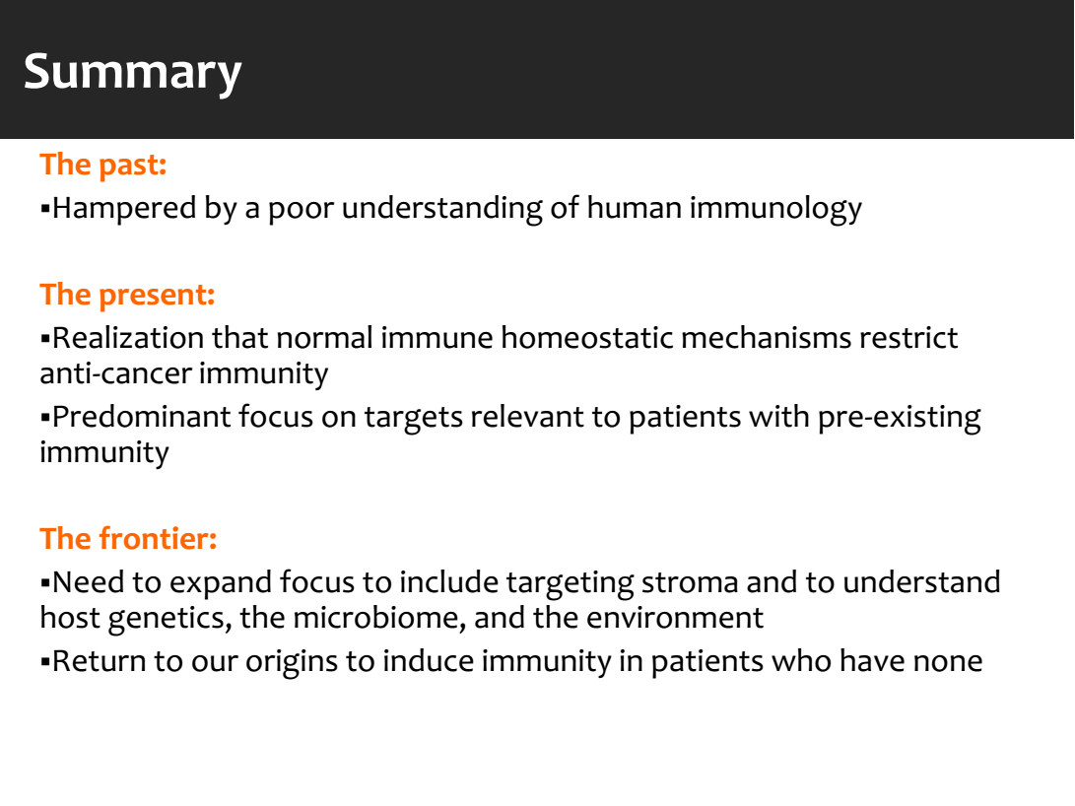

Slide 30
Acknowledgement
Chihiro Morishima, MD
Director, Research Testing Services
Co-Director, Clinical Immunology Lab
Associate Professor, Department of Laboratory Medicine
University of Washington
Beyond Checkpoint Blockade for Cancer Immunotherapy
Prof. James P. Allison
Professor and chair of immunology and executive director of immunotherapy platform at the MD Anderson Cancer Center at the University of Texas.
Immune Checkpoint Blockade in Cancer Therapy
Ira Mellman
Genentech
South San Francisco, California
The immunotherapy of cancer: past, present & the next frontier
Department of Biochemistry and Biotechnology

